Slide 1
HARDWARE FAILURE ANALYSIS REPORT
EDS-510A-3SFP V2.0.0
Negative Fuse (F2/F4) Blown Failure Analysis
Dual-Power Hot-Plugging Investigation.

Slide 2
TABLE OF CONTENTS
Outline
1. Preview
2. Product Review
2.1 INFORMATION GATHERING & STATISTICS
2.2 SCHEMATIC TOPOLOGY DISCOVERY
2.3 TEST SETUP & HARDWARE SPECIFICATIONS
3. FAILURE TREE ANALYSIS (FTA)
4. EXPERIMENTAL VERIFICATIONs
5. FAILURE ANALYSIS
5.1 Conclude the FTA
5.2 CONFIRMED ROOT CAUSE SCENARIOS
5.3 SUPPLEMENTARY - Red Team Findings
6. CORRECTIVE ACTIONS

Slide 3
SECTION 1 : EXECUTIVE SUMMARY
1. Preview
Anomaly
3.34% (10/300) negative fuse (F2/F4) blown at T1, T3 station.
Possible Causes
Capacitor inrush surge, component breakdown, or hot-plug mis-insertion.
Root Cause (Please check the analysis in this slides)
Unkeyed 2-pin hot-plugging into 6-pin header triggers 13A loop across VIN-.
Solutions
Keyed 6-pin plugs, and cold-plug SOP.

Slide 4
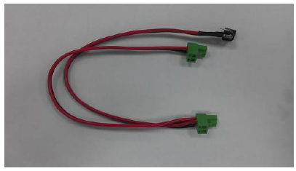
2. PRODUCT REVIEW
2.1 INFORMATION GATHERING & STATISTICS
3.34%
Check w/ subcontractor (DDC):
Test Fixture: L-00166
Unkeyed, 2pins terminal block
Single input w/ 2 output branches for Vin1, Vin2.
10 failures out of 300 units in MP lot (No ECN)
Model: 3055051000001
MO#: 000007034991
  T1_MP testing : 1pce
  T1_EOT Flag setting: 5pcs
  T3_MAC/SN: 4pcs
Negative Fuse Only (F2 or F4)
Random distribution on V1- or V2-; zero positive fuse (F1/F3) failures.
100% Recovery After Fuse Swap
Intact ceramic package; fully recover after fuse replacement.

Slide 5
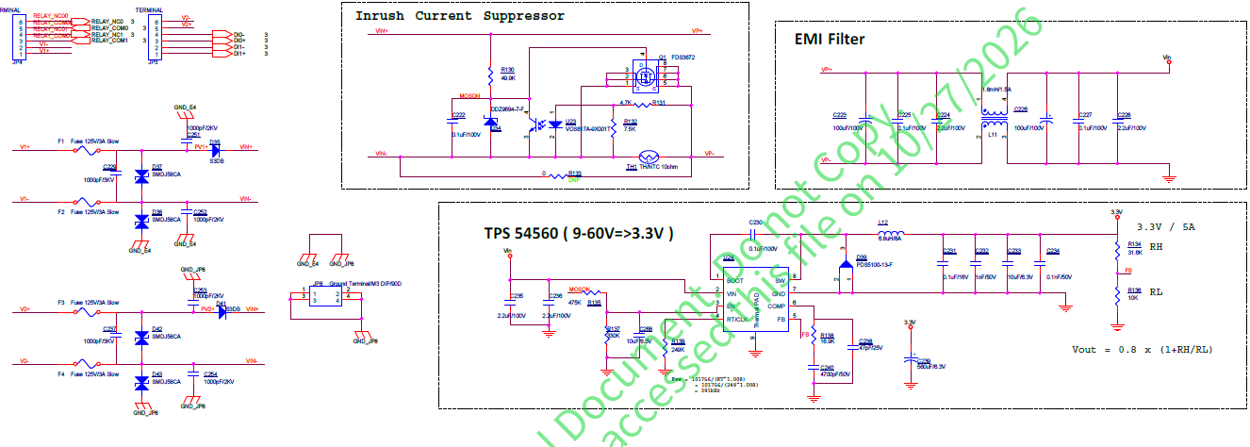
2. PRODUCT REVIEW
2.2 SCHEMATIC TOPOLOGY DISCOVERY
Total Cap.: 208 µF
2-Pin Plug
Unkeyed live hot-plugging into 6-pin headers
Single DC source tied to both Vin1 and Vin2
DC Source
(24V / 13A)
I²t: 20.16 A²s
Positive Diode Isolation: D35 and D41 (S3DB) block reverse current on V1+ and V2+.
Hard-Tied Return Bus: V1- (F2) and V2- (F4) connect directly to VIN- without isolation diodes.
Inrush limiter via NTC: 10ohm NTC implemented in negative power path to suppress the inrush during power on stage.

Slide 6
SECTION 3 : HYPOTHESIS GENERATION
3. FAILURE TREE ANALYSIS (FTA)
Top Event:
Negative Fuse(F2/F4) Blown
[A] Design Topology
[B] Material Specs
[C] Process Quality
[D] Test & Human
A1: Hard-tied VIN- bus.
A2: Q1 NTC bypass.
A3: TVS breakdown.
B1: Fuse thermal aging.
B2: 208µF bulk cap charging surge.
C1: Terminal contact resistance current hogging.
D1: Unkeyed 2-pin mis-plug.
D2: Shared DC source loop.

Slide 7
SECTION 4 : EXPERIMENTAL VERIFICATIONs
Measured Inrush Energy vs. Fuse Melting Threshold
1. Normal Hot-Plug Inrush (10Ω NTC Active):
… view the current waveforms in next page.
2. Hard Charge Without NTC (Q1 Bypassed):
3. External Short-Circuit Melting Time (13A CC):

Slide 8
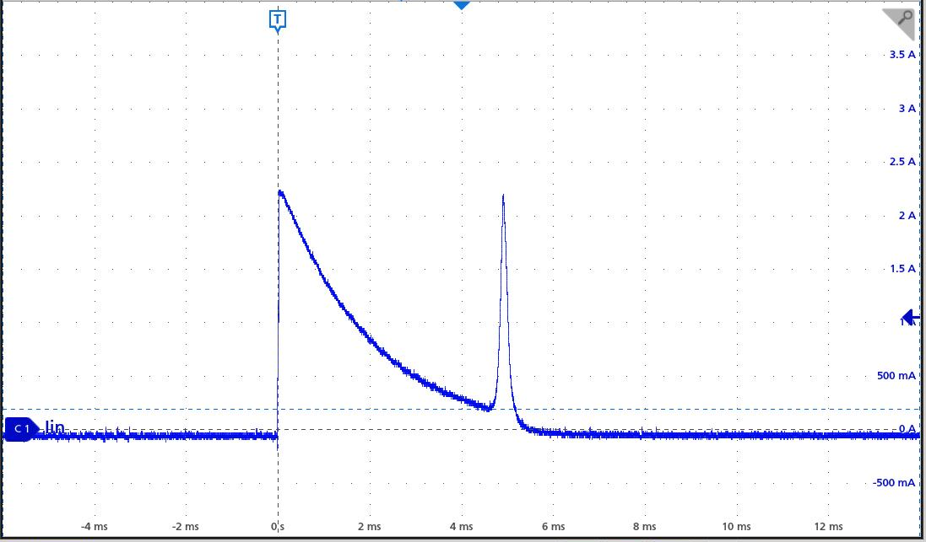
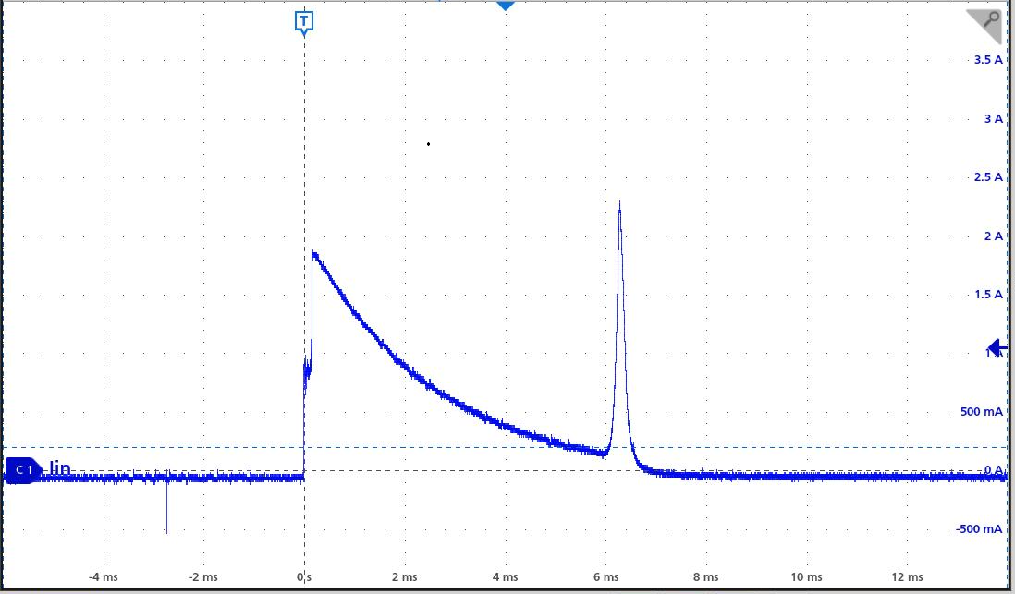
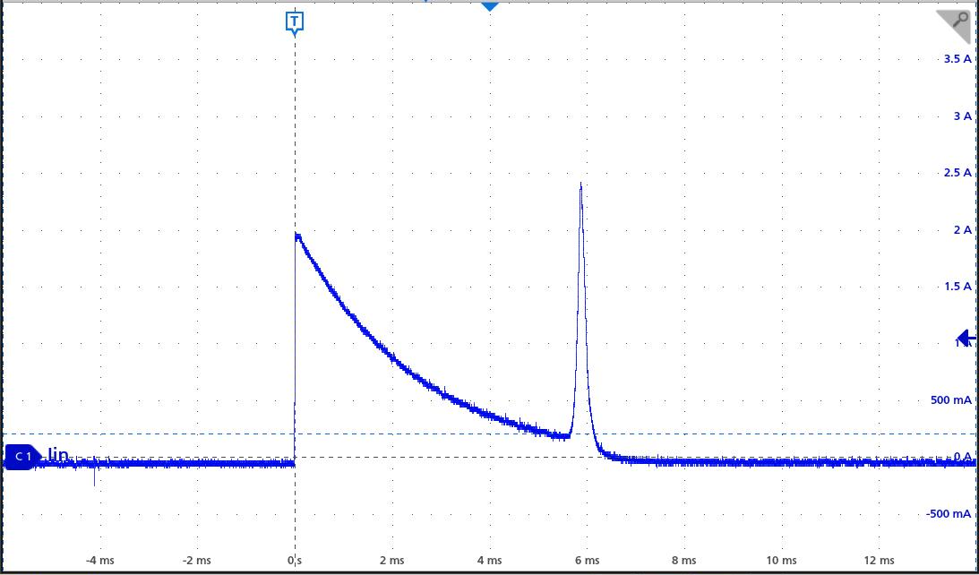
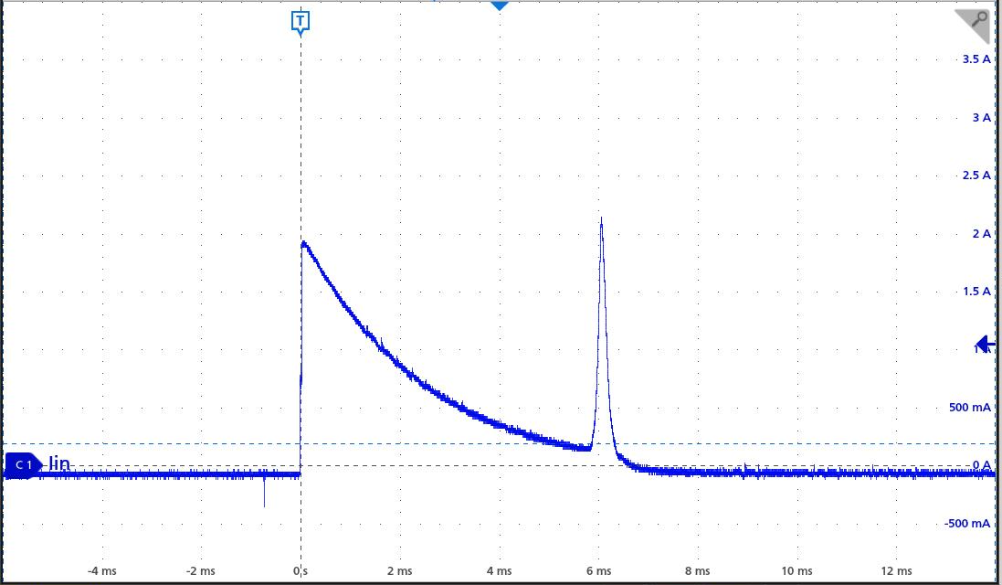

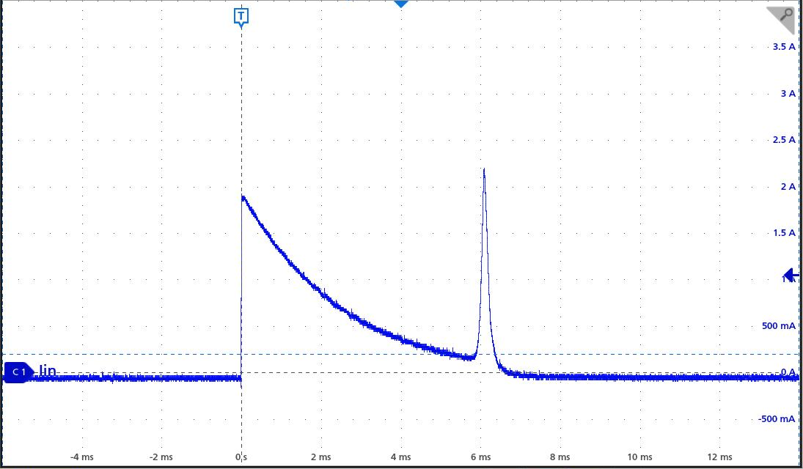
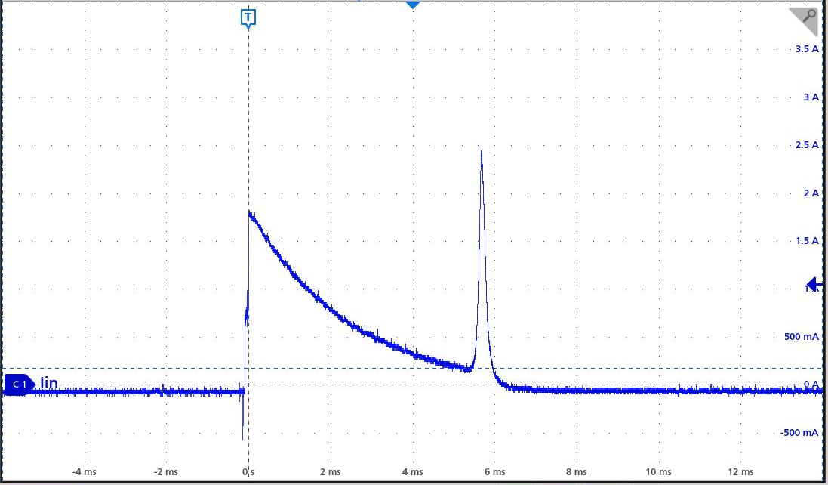
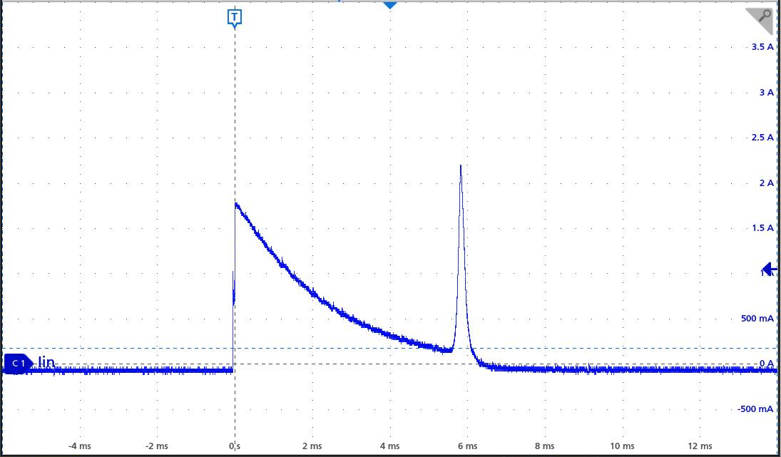
Good | NG#1 | NG#2 | NG#3
Vin1 | Vin1 | Vin1 | Vin1
Vin2 | Vin2 | Vin2 | Vin2
PASS
PASS
PASS
PASS
3A
PASS
PASS
PASS
PASS
3A
Inrush peak values of 4 samples are all lower than 3A. Fuse won’t be blown.

Slide 9
5. FAILURE ANALYSIS
5.1 Conclude the FTA
Top Event:
Negative Fuse(F2/F4) Blown
[A] Design Topology
[B] Material Specs
[C] Process Quality
[D] Test & Human
A1: Hard-tied VIN- bus.
Contribution, No return diode between F2 and F4
B1: Fuse thermal aging.
Ruled out, extremely low rated current (max.: 1A)
C1: Terminal contact resistance current hogging.
Ruled out, extremely low rated current (max.: 1A)
D1: Unkeyed 2-pin mis-plug.
Root cause, reserve/ shift the plug
D2: Shared DC source loop.
Root cause, 119.3ms blow
A2: Q1 NTC bypass.
Ruled out, Max.0.3A²s
Appen. MQITS-9144 & QARM-431
B2: 208µF bulk cap charging surge.
Ruled out, inrush<2.5A
A3: TVS breakdown.
Ruled out, MW Power output 24V within the product spec.

Slide 10
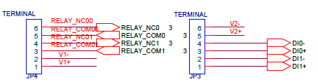
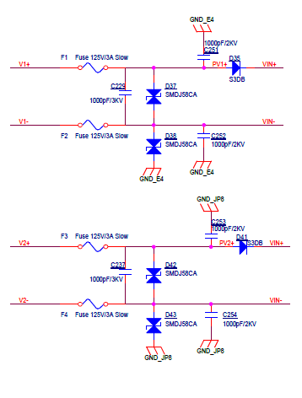
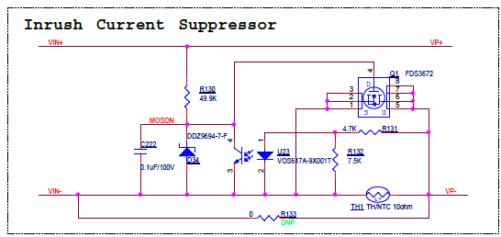
5. FAILURE ANALYSIS
5.2 CONFIRMED ROOT CAUSE SCENARIOS
Scenario 1: 180° Reverse Polarity
Pinout Trap: JP4 has V1+ on outer edge (Pin 1); JP3 has V2- on outer edge (Pin 6).
2: -
1: +
Action: Vin1 plugged first (VIN- = 0V); unkeyed Vin2 plug inserted 180° reversed into JP3.
6: +
5: -
Short Path: +24V (JP3 Pin 6) → F4 → VIN- → F2 → 0V (JP4 Pin 2).
+
-
-
+

Slide 11
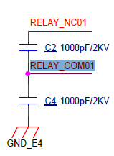
5. FAILURE ANALYSIS
5.2 CONFIRMED ROOT CAUSE SCENARIOS
Scenario 2: JP4 1-Pin Inward Shift
Sequence: Operator connects JP3 (Vin2) first; Power#2 LED turns ON (VIN- = 0V).
3: -
2: +
Action: Correct-polarity 2-pin plug shifted 1 pin inward on JP4 (into Pin 2 & Pin 3).
6: -
5: +
Short Path: +24V (JP4 Pin 2) → F2 → VIN- → F4 → 0V (JP3 Pin 6).
-
+
+
-

Slide 12
5. FAILURE ANALYSIS — SUPPLEMENTARY VERIFICATION
5.3 SUPPLEMENTARY - Red Team Findings
Q1: Why did no positive fuses (F1/F3) blow during random mis-plugging?
A1: Oring diodes D35/D41 block reverse 0V on V1+/V2+; only non-isolated VIN- allows a 13A loop across F2 and F4.
Q2: Why is the fuse package intact without arcing marks or operator notice?
A2: 13A CC limit triggers clean internal melting in just 119.3ms during brief plug contact.
Q3: Why do faulty workstations, whose standard operating procedures (SOPs) all define using a single power supply, still experience fuse failures??
A3-1:
If a product's fuse is damaged due to a dual-power supply, the remaining unmelted fuse may still contain the existing damage, and the inrush upon the next power-on could cause it to melt completely.
A3-2:
It is necessary to clarify whether the on-site operators followed the SOP and used only a single power supply. If dual power supplies were used, the same possibility still exists..

Slide 13
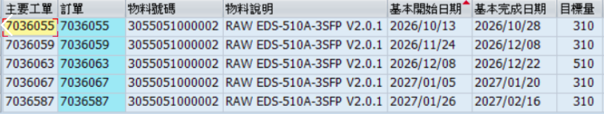
SECTION 6 : CAPA IMPLEMENTATION
6. CORRECTIVE ACTIONS
1. Keyed 6-Pin Plugs
Replace unkeyed 2-pin plugs with poka-yoke 6-pin connectors.
2. Cold-Plug SOP
Forbid live hot-plugging; connect cables before DC output ON.
Total: 1440pcs be produced after 11/24.
Failure rate should be lower than 3.34% via the test fixture optimization.
3. Pair Fuse Rework
Replace both F2 and F4 simultaneously on all failed units.

Slide 14
Thank You

